Slide 1
Working in MATLAB

Slide 2
Working in MATLAB
You can perform operations in MATLAB in two ways:
In the interactive mode, in which all commands are entered directly in the Command window, or
2. By running a MATLAB program stored in script file. This type of file contains MATLAB commands, so running it is equivalent to typing all the commands—one at a time—at the Command window prompt. You can run the file by typing its name at the Command window prompt.

Slide 3
Working in MATLAB
Keep in mind when using script files:
1. The name of a script file must begin with a letter, and may include digits and the underscore character, up to 63 characters.
2. Do not give a script file the same name as a variable.
3. Do not give a script file the same name as a MATLAB command or function. You can check to see if a command, function or file name already exists by using the exist command.

Slide 4
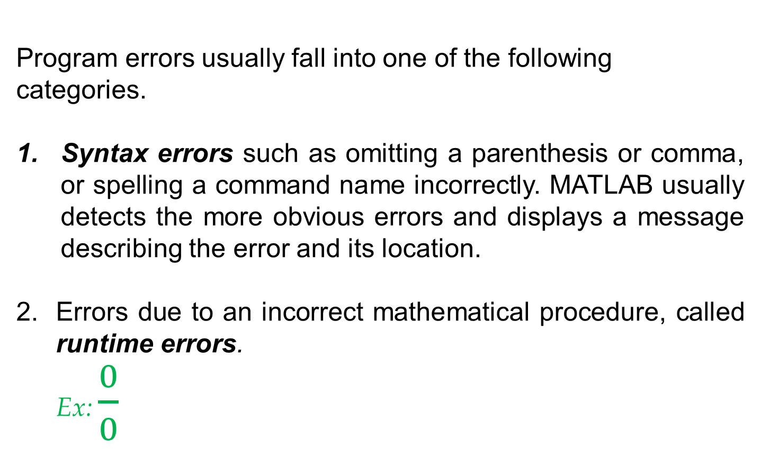
Working in MATLAB - Debugging Script Files
Program errors usually fall into one of the following
categories.
Syntax errors such as omitting a parenthesis or comma, or spelling a command name incorrectly. MATLAB usually detects the more obvious errors and displays a message describing the error and its location.
Errors due to an incorrect mathematical procedure, called runtime errors.
Ex: $\frac{0}{0}$

Slide 5
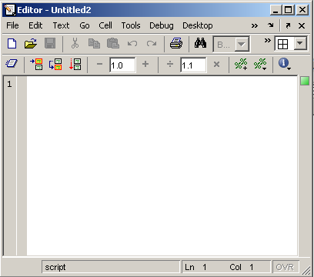
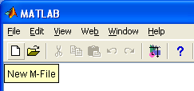
Use of M-File
Click to create a new M-File
Extension “.m”
A text file containing script or function or program to run

Slide 6
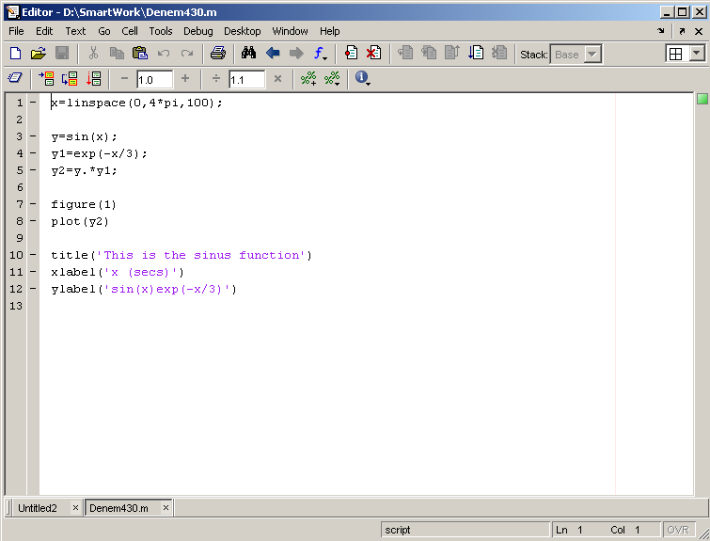
Use of M-File
Save file as Denem430.m
If you include “;” at the
end of each statement,
result will not be shown
immediately

Slide 7
Working in MATLAB - Programming Style
Comments section
a. The name of the program and any key words in the first line.
b. The date created, and the creators' names in the second line.
c. The definitions of the variable names for every input and output
variable. Include definitions of variables used in the calculations
and units of measurement for all input and all output variables!
d. The name of every user-defined function called by the program.

Slide 8
Working in MATLAB - Programming Style
Input section Include input data and/or the input functions and comments for documentation.
Calculation section
4. Output section This section might contain functions for displaying the output on the screen.

Slide 9
Working in MATLAB - Programming Style- Example
Problem:
The speed v of a falling object dropped with no initial velocity is given as a function of time t by v = gt. Plot v as a function of t for 0 < t < t_{final}, where t_{final} is the final time entered by the user.
% Program falling_speed.m:
% Plots speed of a falling object.
% Created on June 30, 2017 by MARK
%
% Input Variable:
% tfinal = final time (in seconds)
%
% Output Variables:
% t = array of times at which speed is computed in seconds
% v = array of speeds (meters/second)
%

Slide 10
Working in MATLAB - Programming Style- Example
% Parameter Value:
g = 9.81; % Acceleration in SI units
%
% Input section:
tfinal = input(’Enter final time in seconds:’);
%
% Calculation section:
dt = tfinal/500;
%
% Create an array of 501 time values.
t = 0:dt:tfinal;
% Compute speed values.
v = g*t;
%
% Output section:
Plot(t,v),xlabel(’t (s)’),ylabel(’v m/s)’)
%

Slide 11
The Help System
Search for appropriate function
>> lookfor keyword
Rapid help with syntax and function definition
>> help function
An advanced hyperlinked help system is launched by
>> helpdesk
Complete manuals (html & pdf)
http://www.mathworks.com/access/helpdesk/help/helpdesk.html

Slide 12
The help system example
Step 1:
>> lookfor convolution
CONV Convolution and polynomial multiplication.
CONV2 Two dimensional convolution.
CONVN N-dimensional convolution.
DECONV Deconvolution and polynomial division.
CONVENC Convolutionally encode binary data.
DISTSPEC Compute the distance spectrum of a convolutional code.
...
>> help conv
CONV Convolution and polynomial multiplication.
C = CONV(A, B) convolves vectors A and B. The resulting
vector is length LENGTH(A)+LENGTH(B)-1.
If A and B are vectors of polynomial coefficients,
convolving them is equivalent to multiplying the two
polynomials.
Class support for inputs A,B:
float: double, single
See also deconv, conv2, convn, filter and, in the Signal
Processing Toolbox, xcorr, convmtx....
Step 2:

Slide 13
The help system - Example
Step 3: doc funcname: Opens the Help Browser to the reference page for the specified function funcname, providing a description, additional remarks, and examples.

Slide 14
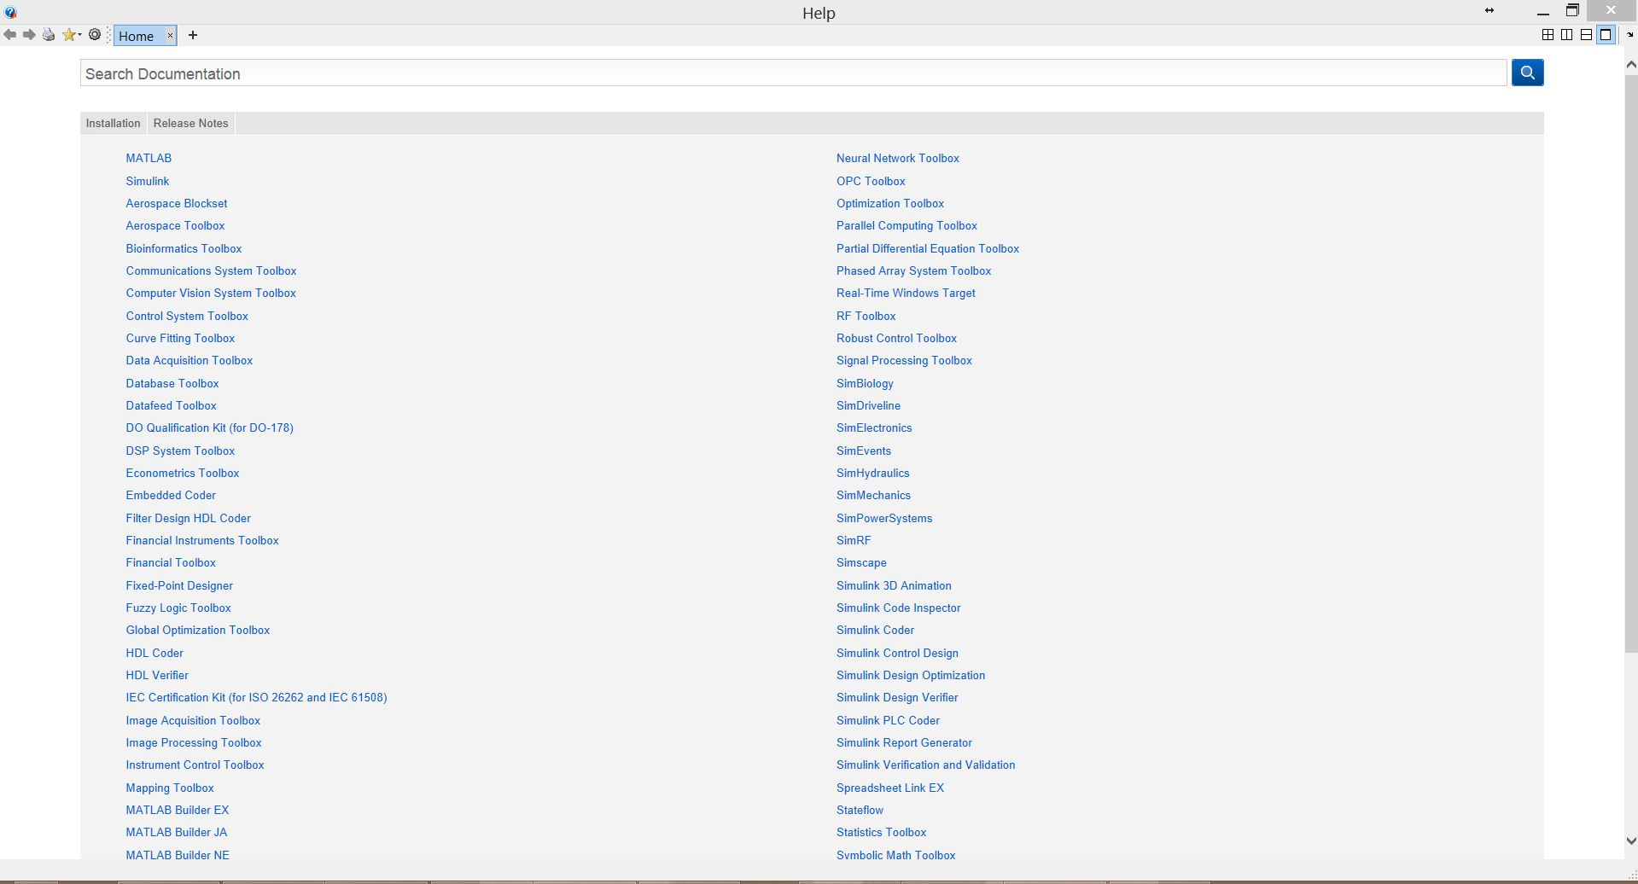
The help system

Slide 15
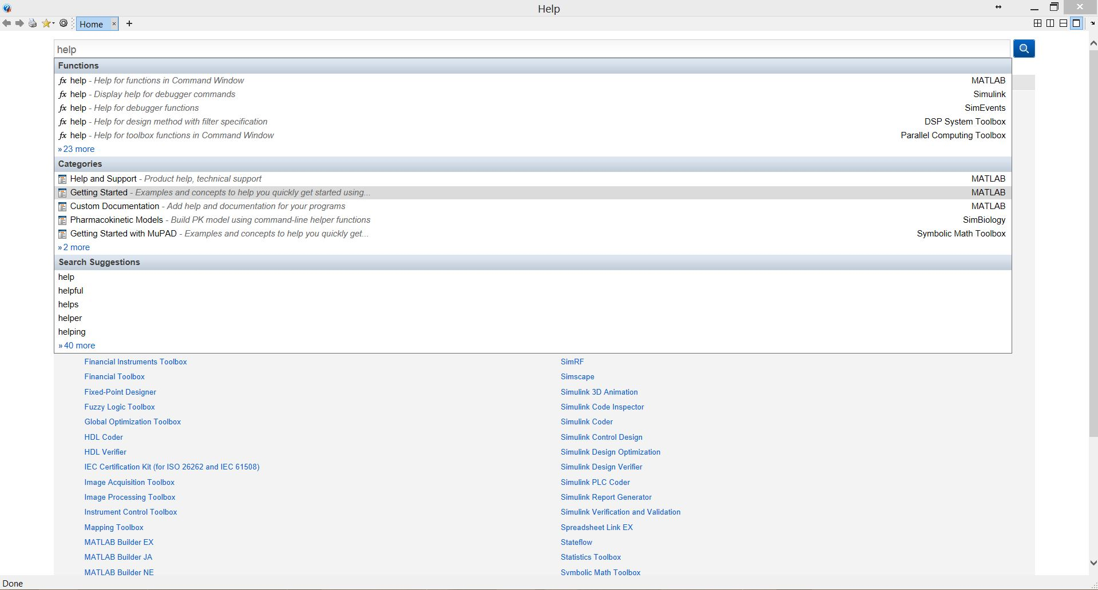
The help system

Slide 16
Note
“%” is the neglect sign for Matlab (equaivalent of “//” in C). Anything after it on the same line is neglected by Matlab compiler.
Sometimes slowing down the execution is done deliberately for observation purposes. You can use the command “pause” for this purpose
pause %wait until any key
pause(3) %wait 3 seconds

Slide 17
Useful Commands
The two commands used most by Matlab
users are
>>help functionname
>>lookfor keyword

Slide 18
Interactive Calculations
Matlab is interactive, no need to declare variables
>> 2+3*4/2
>> a=5e-3; b=1; a+b
Most elementary functions and constants are already defined
>> cos(pi)
>> abs(1+i)
>> sin(pi)

Slide 19
Math
MATLAB can do simple math just as a calculator.
OPERATION | SYMBOL | EXAMPLE
Addition, a + b | + | 3 + 22
Subtraction, a – b | - | 90-44
Multiplication, a*b | * | 3.14*4.20
Division, a b | / or \ | 56/8 = 8\56
Exponentiation, a^{b} | ^ | 2^16

Slide 20
MATLAB Variable Names
Variable names are cASE sENSITIVE
Variable names can contain up to 63 characters (as of MATLAB 6.5 and newer)
Variable names must start with a letter followed by letters, digits, and underscores.
All variables are shown with
>> who
>> whos
Variables can be stored on file
>> save filename
>> clear
>> load filename

Slide 21
MATLAB Special Variables
ans Default variable name for results
pi Value of π
inf
NaN Not a number e.g. 0/0
i and j i = j =
eps Smallest incremental number
realmin The smallest usable positive real number
realmax The largest usable positive real number

Slide 22
Some Useful MATLAB commands
what List all m-files in current directory
dir List all files in current directory
ls Same as dir
type test Display test.m in command window
delete test Delete test.m
cd a: Change directory to a:
chdir a: Same as cd
pwd Show current directory
which test Display current directory path to test.m

Slide 23
Functions
MATLAB has many built-in functions.
Some math functions are:
acos, acosh acot, acsc, acsch, asec, asech, asin, asinh, atan, atan2, atanh, cos, cosh, cot, coth, csc, csch, sec, sech, sin, sinh, tan, tanh, exp, log, log10, log2, pow2, sqrt, nextpow2, abs, angle, conj, imag, real, unwrap, isreal, cplxpair, fix, floor, ceil, round, mod, rem, sign, cart2sph, cart2pol, pol2cart, sph2cart, factor, isprime, primes, gcd, lcm, rat, rats, perms, nchoosek, airy, besselj, bessely, besselh, besseli, besselk, beta, betainc, betaln, ellipj, ellipke, erf, erfc, erfcx, erfinv, expint, gamma, gammainc, gammaln, legendre, cross, dot

Slide 24
MATLAB Math & Assignment Operators
Power ^ or .^ a^b or a.^b
Multiplication * or .* a*b or a.*b
Division / or ./ a/b or a./b
or \ or .\ b\a or b.\a
NOTE: 56/8 = 8\56
- (unary) + (unary)
Addition + a + b
Subtraction - a - b
Assignment = a = b (assign b to a)

Slide 25
MATLAB Matrices
MATLAB treats all variables as matrices. For our purposes a matrix can be thought of as an array, in fact, that is how it is stored.
Vectors are special forms of matrices and contain only one row OR one column.
Scalars are matrices with only one row AND one column

Slide 26
Polynomial example
Find polynomial roots:
>> x=[1.2,0.5,4,10]
x =
1.200 0.500 4.00 10.00
>> roots(x)
ans =
0.59014943179299 + 2.20679713205154i
0.59014943179299 - 2.20679713205154i
-1.59696553025265

Slide 27
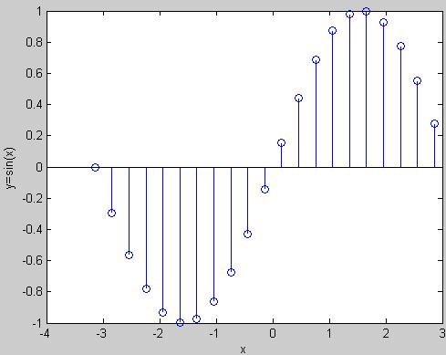
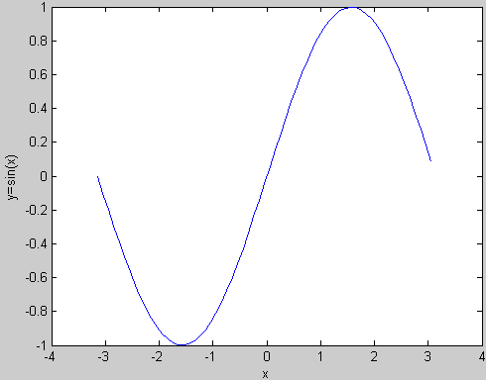
Graphics
Visualization of vector data is available
>> x=-pi:0.1:pi; y=sin(x);
>> plot(x,y)
>> xlabel(’x’); ylabel(’y=sin(x)’);
plot(x,y)
stem(x,y)

Slide 28
Integration example
Find the integral:
example with trapz function:
>> x = 0:0.5:10; y = 0.5 * sqrt(x) + x .* sin(x);
>> integral1 = trapz(x,y)
integral1 =
18.1655

Slide 29
Symbolic Math Toolbox –Integration & Differentiation
The Symbolic Math Toolbox uses "symbolic objects" produced by the "sym" funtion.
>> x = sym('x'); % produces a symbolic variable named x
>> f=x^3; % defines a function
Example:
- ?
- ?
>> x = sym('x');
>> diff(x^3)
ans =
3*x^2
>> int(x^3)
ans =
1/4*x^4

Slide 30
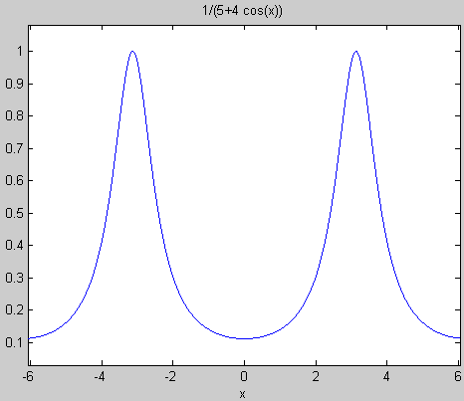
Symbolic Math Toolbox
Once a symbolic variable is defined, you can use it to build functions. EZPLOT makes it easy to plot symbolic expressions.
>> x = sym('x');
>> f = 1/(5+4*cos(x))
>> ezplot(f)
>> help ezplot
ezplot Easy to use function plotter
ezplot(FUN) plots the function FUN(X) over the default domain
-2*PI < X < 2*PI, where FUN(X) is an explicitly defined function of X.

Slide 31
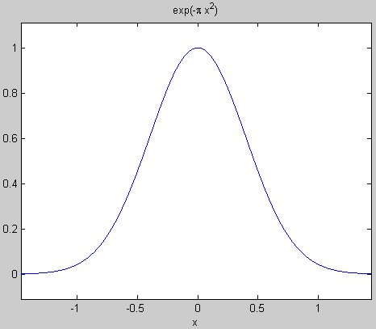
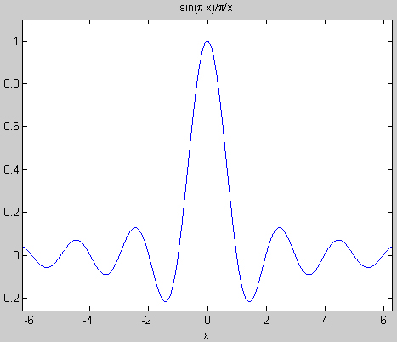
Symbolic Math Toolbox
Plot the following functions:
>> x = sym('x');
Gaussian
>> ezplot (exp(-pi*x*x))
sinc(x)=si(πx)=sin(πx)/(πx)
>> ezplot(sinc(x))

